Slide 1

Cinema Project
Tasnima Monaf

Slide 2
Contents
1. Planning on Jira Board
2. Technologies used Overview
3. Back-End
Java – Spring Boot
MySQL
H2 Console
Postman
4. Front-End
HTML File
JavaScript File
CSS File
5. Risk Assessment
6. Summary
7. Q&A
Demonstration

Slide 3
Planning
Using the Kanban Board: Jira
Created 3 Epics for different parts of the project
To Create OOP Front-End Development
To Create Back-End Development
Documentation
Each epic consisted of User Stories
Some User Stories had child issues
Jira Board: https://tasnima23.atlassian.net/jira/software/projects/CINEMA/boards/2/roadmap

Slide 4
Technologies used Overview
In this project, the technologies used were the technologies covered in the training period
Kanban Board: Jira
Database: SQL Server
Programming language: Java
Front-end: HTML, CSS and JavaScript
Integration Tests: MockMVC
Version Control: Git

Slide 5
Demonstration
I will now demonstrate the application

Slide 6
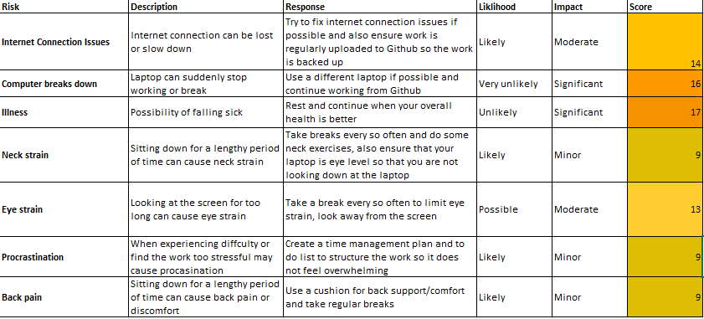
Risk Assessment

Slide 7
Summary
In summary
What worked well for me
Functioning CRUD Functionality on Back-End
Passed Integration Test
CRUD functionality demonstrated on Front-End Application
What didn’t go well for the project
Struggled with connecting the functions on JavaScript on the Front-End
Basic website design due to time constraints
What could I have done differently
Better time-management

Slide 8
Q&A

